Slide 1

Yan Fei

Slide 2
Contents
Concepts
Cause of Fading
Fading Types
Fading Models

Slide 3
Concepts
What is Fading?
  It is about the phenomenon of loss of signal in telecommunications.
  A fading channel is a communication channel that experiences fading.
Notes:
It refers to the distortion that a carrier-modulated telecommunication signal experiences over certain propagation media.

Slide 4
Cause of Fading
In wireless systems, fading is due to multipath propagation.
Multipath is the propagation phenomenon that results in radio signals' reaching the receiving antenna by two or more paths.
Causes of multipath include atmospheric ducting, ionospheric reflection and refraction, and reflection from terrestrial objects, such as mountains and buildings.
Notes:
In wireless communications, signal fading is caused by multi-path effect. Multi-path effect means that a signal transmitted from a transmitter may have multiple copies traversing different paths to reach a receiver. Thus, at the receiver, the received signal should be the sum of all these multi-path signals. Because the paths traversed by these signals are different; some are longer and some are shorter. The one at the direction of light of signal (LOS) should be the shortest. These signals interact with each other. If signals are in phase, they would intensify the resultant signal; otherwise, the resultant signal is weakened due to out of phase. This phenomenon is called channel fading. In general, there are two criteria to measure channel fading, including (1) Doppler spread, and (2) delay spread.

Slide 5
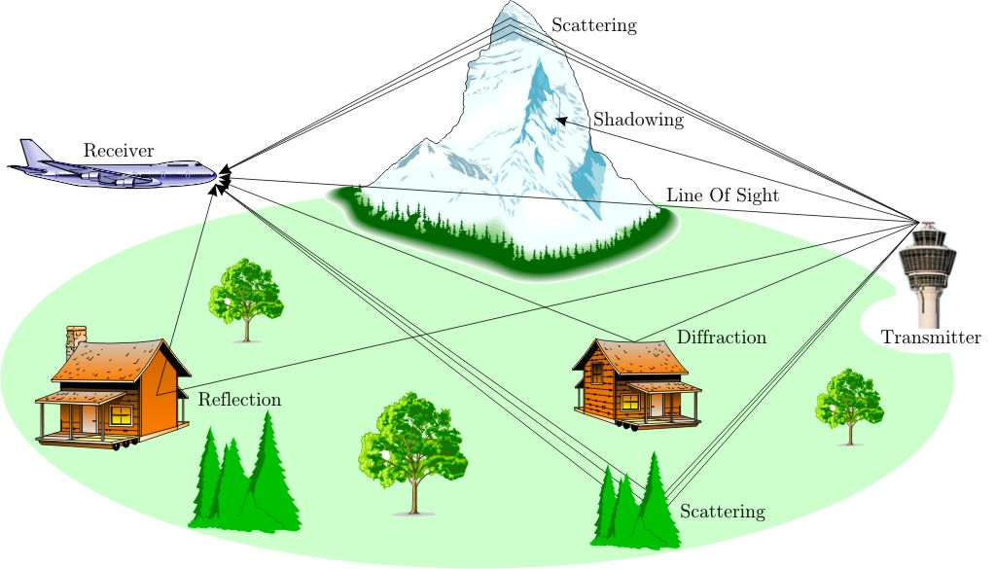
Cause of Fading

Slide 6
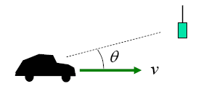
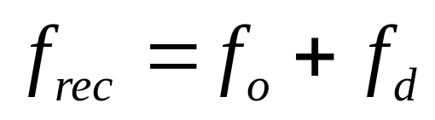
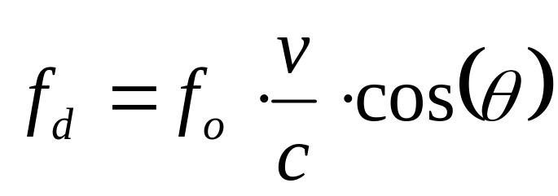
Fading Types
Doppler Spread
  Suppose a mobile transmitting at carrier
  frequency f_{o} approaches a stationary receiver at an angle θ and a speed of v
  The carrier frequency of the received signal will be
(When θ=0˚, Maximum Doppler Shift)

Slide 7
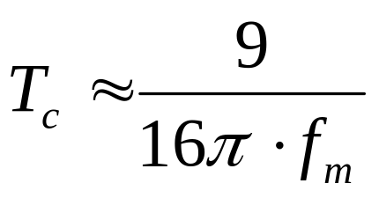
Fading Types
Coherence Time
  T_{c} is the time domain of Doppler spread and is used to characterize the time varying nature of the frequency dispersiveness of the channel in the time domain.
  If the coherence time is defined as the time over which the time correlation function is above 0.5, then the coherence time is approximately
(f_{m} is the Maximum Doppler Shift)
Notes:
Corresponding to Doppler spectrum spread, there is a concept called coherence time, which is related to the reciprocal of the maximum Doppler shit. Coherence time is used to measure a time interval, in which a smaller amount of fading is occurred.

Slide 8
Fading Types
Delay spread
  The different signal paths between a transmitter and a receiver correspond to different transmission times.
  The direct effect of these unsimultaneous arrivals of signal causes the spread of the original signal in time domain.
Notes:
The different signal paths between a transmitter and a receiver correspond to different transmission times. For an identical signal pulse from the transmitter, multiple copies of signals are received at the receiver at different moments. The signals on shorter paths reach the receiver earlier than those on longer paths. The direct effect of these unsimultaneous arrivals of signal causes the spread of the original signal in time domain. This spread is called delay spread. The delay spread puts a constraint on the maximum transmission capacity on the wireless channel. Specifically, if the period of baseband data pulse is larger than that of delay spread, inter-symbol interference (ISI) will be generated at the receiver. That is, the data signals on two neighbouring pulse periods are received at the same time, which causes the receiver not to be able to distinguish them. Corresponding to the concept of delay spread, there is a term called coherence bandwidth used to measure the up-limit bandwidth that can be transmitted for a channel to be free of ISI.

Slide 9
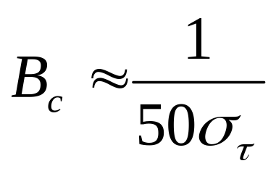
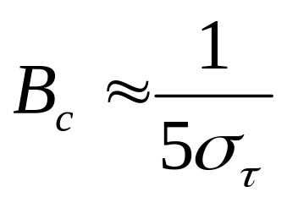
Fading Types
Coherence Bandwidth
  The coherence bandwidth, B_{c} ,a defined relation derived from the root mean square (rms) delay spread.
  90% coherence bandwidth
  50% coherence bandwidth

Slide 10
Fading Types(Based on Doppler Spread)
Fast Fading
Slow Fading
High Doppler spread
Coherence time < Symbol period
Channel variations faster than baseband signal variations
Low Doppler spread
Coherence time > Symbol period
Channel variations slower than baseband signal variations
Notes:
Specifically, if the baseband signal varies faster than the coherence time, the distortion from Doppler spread fading is negligible. Such a situation is called slow fading. Otherwise, if the baseband signal varies more slowly than the coherence time, the distortion from Doppler spread fading may be significant. This situation is called fast fading.
The terms slow and fast fading refer to the rate at which the magnitude and phase change imposed by the channel on the signal changes. The coherence time is a measure of the minimum time required for the magnitude change of the channel to become decorrelated from its previous value.

Slide 11
Fading Types(Based on Delay Spread )
Flat Fading
Frequency Selective Fading
BW of signal < BW of channel
Delay spread < Symbol period
BW of signal > BW of channel
Delay spread > Symbol period
Notes:
If the mobile radio channel has a constant gain and linear phase response over a bandwidth which is greater than the bandwidth of the transmitted signal, then the received signal will under go flat fading. Therefore, all frequency components of the signal will experience the same magnitude of fading. the coherence bandwidth of the channel is smaller than the bandwidth of the signal. Different frequency components of the signal therefore experience decorrelated fading.

Slide 12
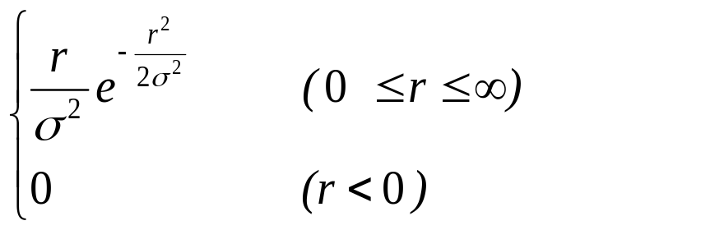
Fading Models
Rayleigh fading
  PDF for Rayleigh Distribution
Rayleigh for non-LOS channels
p(r)
0
.
6065
σ
p(r) =
r = received signal envelope voltage
σ = rms value of received voltage
before envelope detection
σ ² = time average power of received
signal before envelope detection
0 σ 2σ 3σ 4σ 5σ
Notes:
Note that Rayleigh fading is a small-scale effect. There will be bulk properties of the environment such as path loss and shadowing upon which the fading is superimposed.

Slide 13
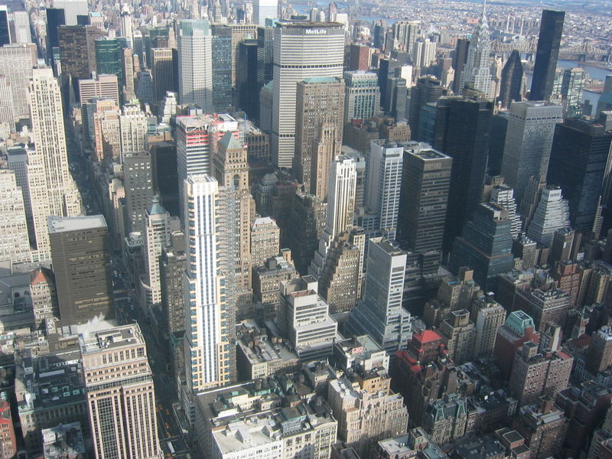
Fading Models
Application for Rayleigh fading
  Rayleigh fading is a reasonable model when there are many objects in the environment that scatter the radio signal before it arrives at the receiver.
Experimental work in Manhattan has found near-Rayleigh fading there
Notes:
Rayleigh fading is a reasonable model when there are many objects in the environment that scatter the radio signal before it arrives at the receiver.
The requirement that there be many scatterers present means that Rayleigh fading can be a useful model in heavily built-up city centres where there is no line of sight between the transmitter and receiver and many buildings and other objects attenuate, reflect, refract and diffract the signal.

Slide 14
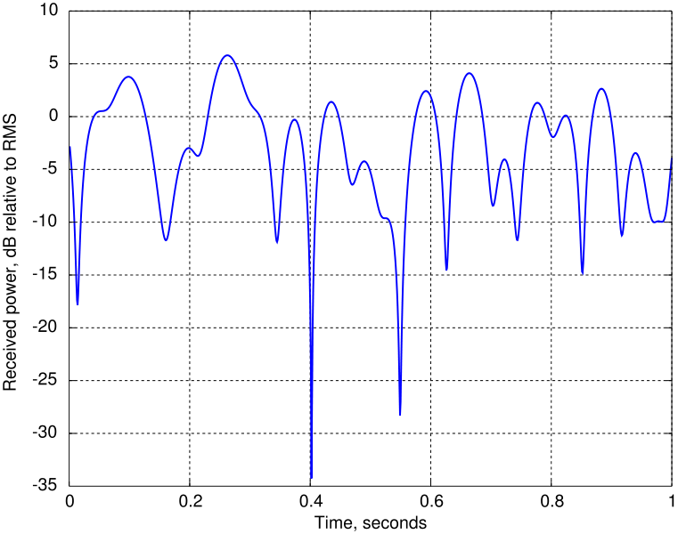
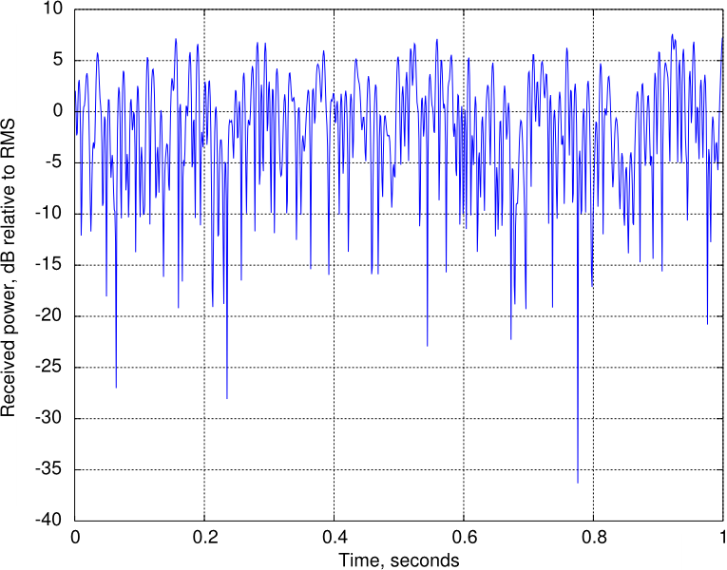
Fading Models
Application for Rayleigh fading
These Doppler shifts correspond to velocities of about 6km/h (4mph) and 60km/h (40mph) respectively at 1800 MHz, one of the operating frequencies for GSM mobile phones.
One second of Rayleigh fading with a maximum Doppler shift of 10Hz.
One second of Rayleigh fading with a maximum Doppler shift of 100Hz.
Notes:
This is the classic shape of Rayleigh fading. Note in particular the 'deep fades' where signal strength can drop by a factor of several thousand, or 30-40 dB.

Slide 15
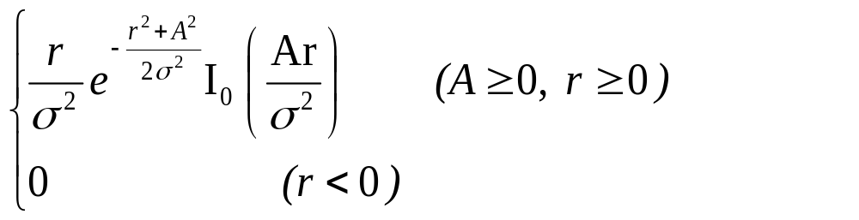
Fading Models
Ricean fading for LOS Channels
  PDF for Ricean Distribution
if signal has – LOS path → small scale fading envelope is Ricean
  random multipath components arriving at different angles are
  superimposed on LOS signal
  as LOS component fades → distribution degenerates to Rayleigh
p(r) =
A = peak amplitude of dominant signal
Ι₀(•) = modified Bessel function of the 1st kind & zero order

Slide 16
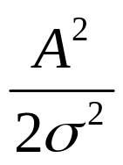
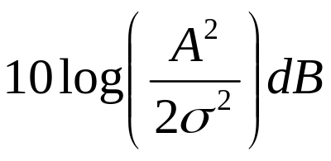
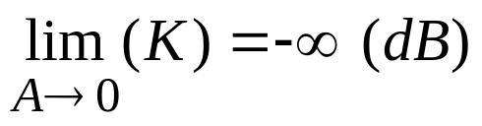
Fading Models
Ricean Distribution often described in terms of parameter K
    K is known as Ricean Factor
    K = ratio of deterministic signal power & multipath variance
K =
p(r)
K (dB) =
K = -∞ dB
K = 6 dB
  as signal attenuates → A grows small
  Ricean distribution degenerates to Rayleigh
0 σ 2σ 3σ 4σ 5σ
Notes:
The Rice factor K = ν2
2σ2 is the relation between the power of the
LOS component and the power of the Rayleigh component.

Slide 17
References
T.S. Rappaport, Wireless Communications: Principles and practice, Second Edition, Prentice Hall
David Tse and Pramod Viswanath, Fundamentals of Wireless Communication, Cambridge University Press, 2005.
http://en.wikipedia.org/wiki/Fading
http://en.wikipedia.org/wiki/Rayleigh_fading

